Slide 1
COUNTERS
10
LEACH, MALVINO & SAHA

Slide 2
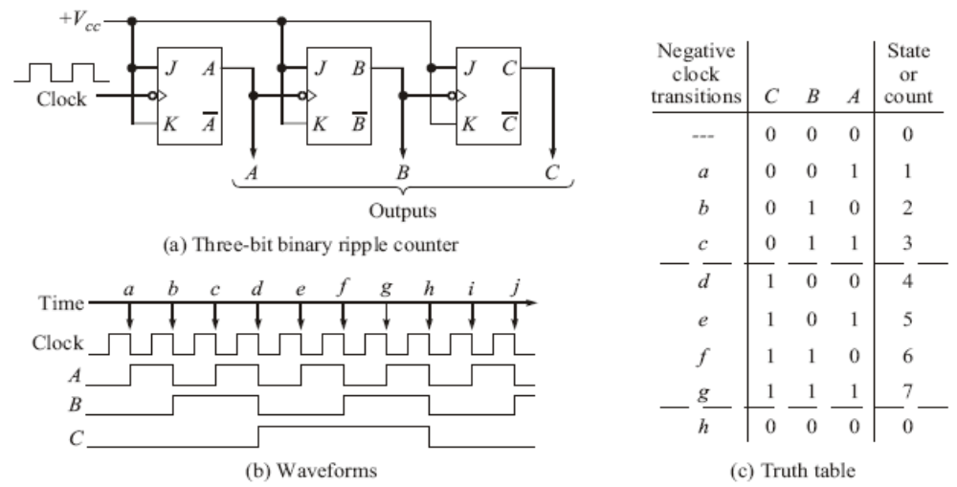
Asynchronous Counters
Ripple Counter
  When the output of a flip-flop is used as the clock input for the next flip-flop, we call the counter a ripple counter, or asynchronous counter.

Slide 3
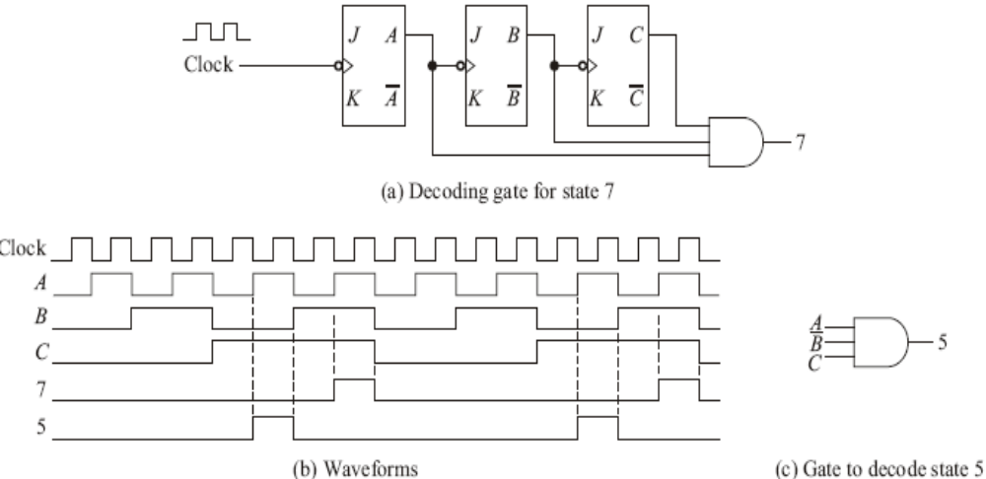
Decoding Gates
A decoding gate can be connected to the outputs of a counter in such a way that the output of the gate will be high (or low) only when the counter contents are equal to a given state.

Slide 4
End of Portion for 2nd Internals
Next Class,
Synchronous Counter

Slide 5
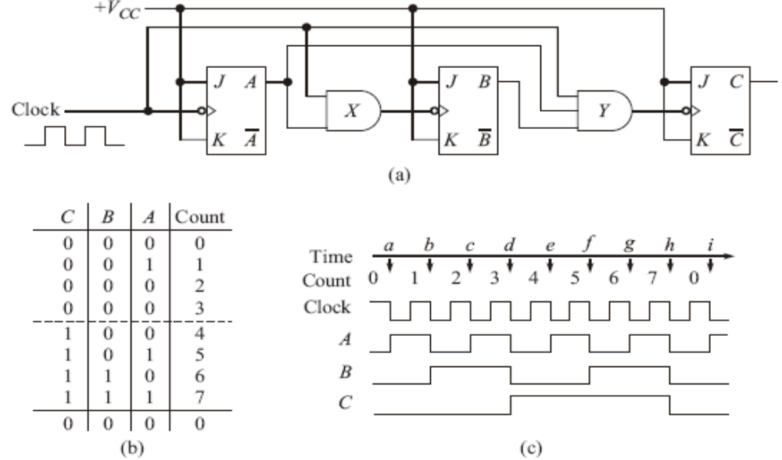
Synchronous Counters
The flip-flop delay time and possibility of glitches are overcome by the use of a synchronous or parallel counter.
Every flip-flop is triggered in synchronism with the clock.
Mod-8 parallel binary counter

Slide 6
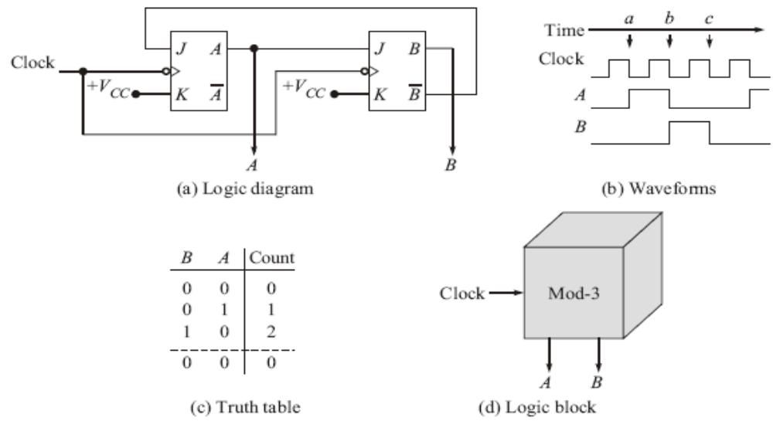
Changing the counter modulus
Counter Modulus
  Counters are said to have a “natural count” of 2^{n}. A counter having a modulus of 3 or 5 would be useful and such counters are said to have a modified count.
A MOD-3 Counter

Slide 7
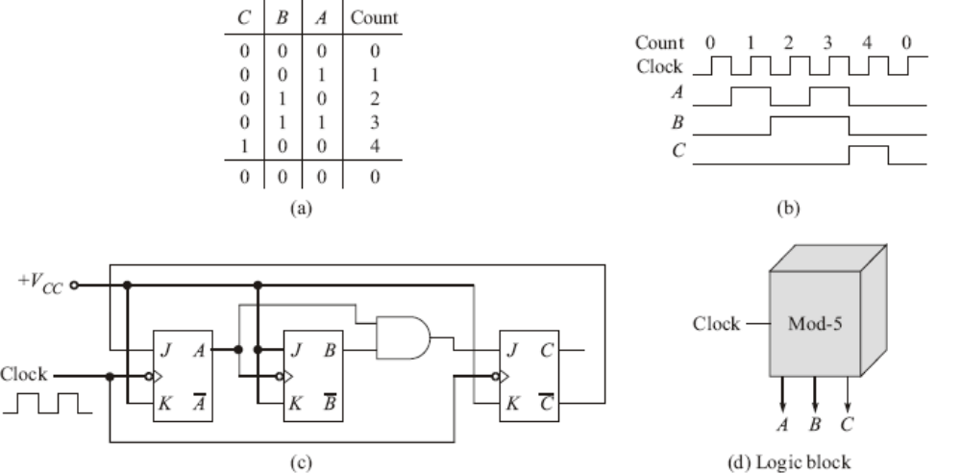
Decade Counters
A MOD-5 Counter

Slide 8
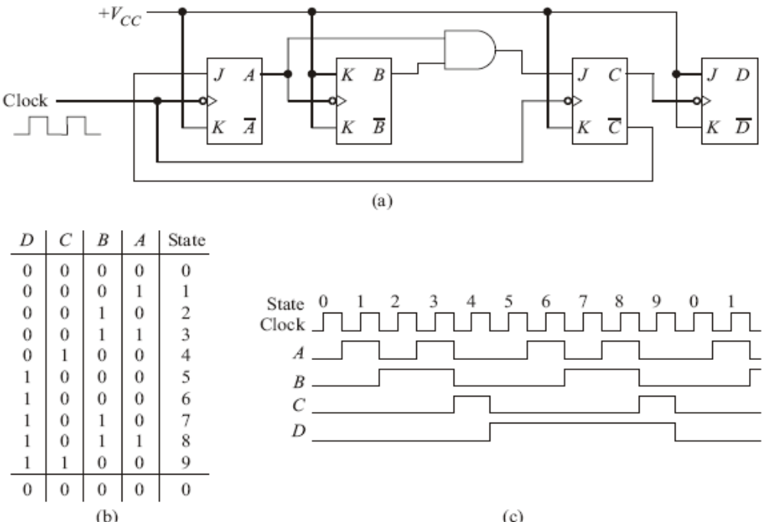
Decade Counters
A MOD-10 Counter
  A 2x5 or a 5x2 will form a mod-10 counter, or a decade counter.

Slide 9
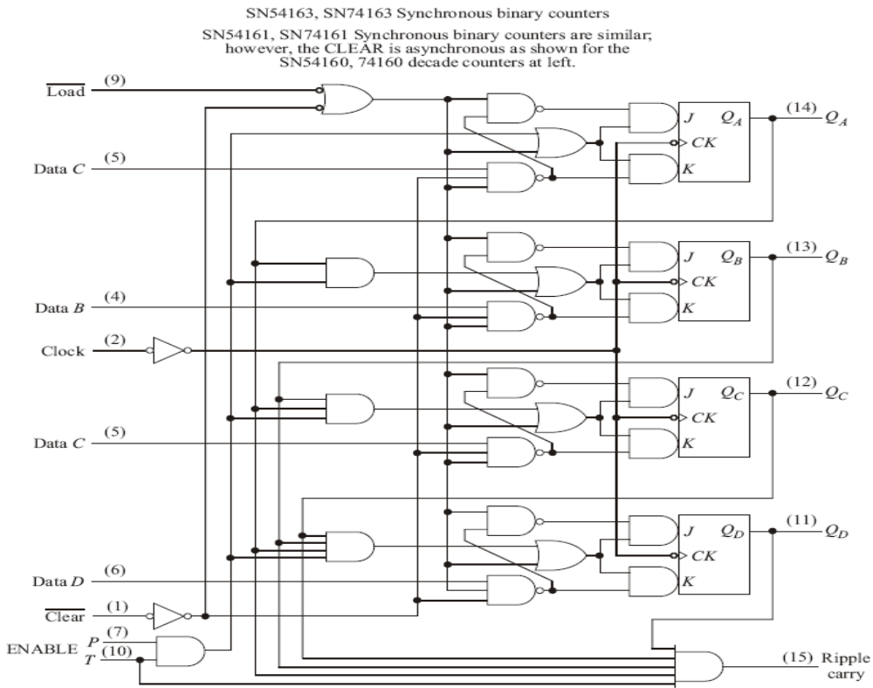
Presettable Counters
Synchronous UP Counters

Slide 10
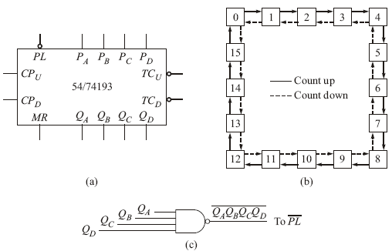
Presettable Counters
Synchronous UP-DOWN Counters

Slide 11
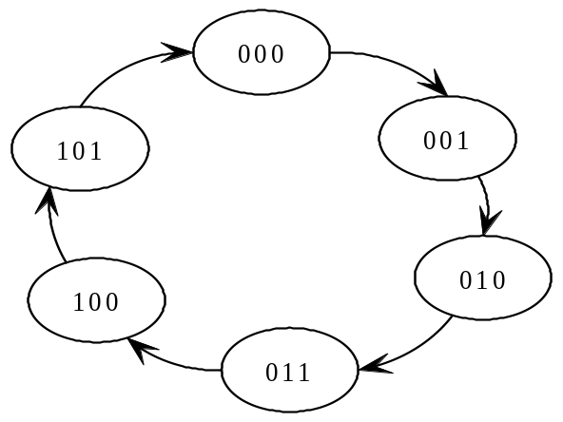
Counter design as a synthesis problem
Let us try to design a modulo-6 counter, the counting states (memory values) of which are shown in state transition diagram. We need three memory element or flip-flops for this as with n flip-flop we can get at most 2n number of different counting states.
C_{n} B_{n} A_{n} | C_{n+1} B_{n+1} A_{n+1} | J_{C} K_{C} | J_{B} K_{B} | J_{A} K_{A}
0 0 0 | 0 0 1 | 0 × | 0 × | 1 ×
0 0 1 | 0 1 0 | 0 × | 1 × | × 1
0 1 0 | 0 1 1 | 0 × | × 0 | 1 ×
0 1 1 | 1 0 0 | 1 × | × 1 | × 1
1 0 0 | 1 0 1 | × 0 | 0 × | 1 ×
1 0 1 | 0 0 1 | × 1 | 0 × | × 1
State table for design of modulo-6 counter given in Fig
State sequence of a modulo-6 counter

Slide 12
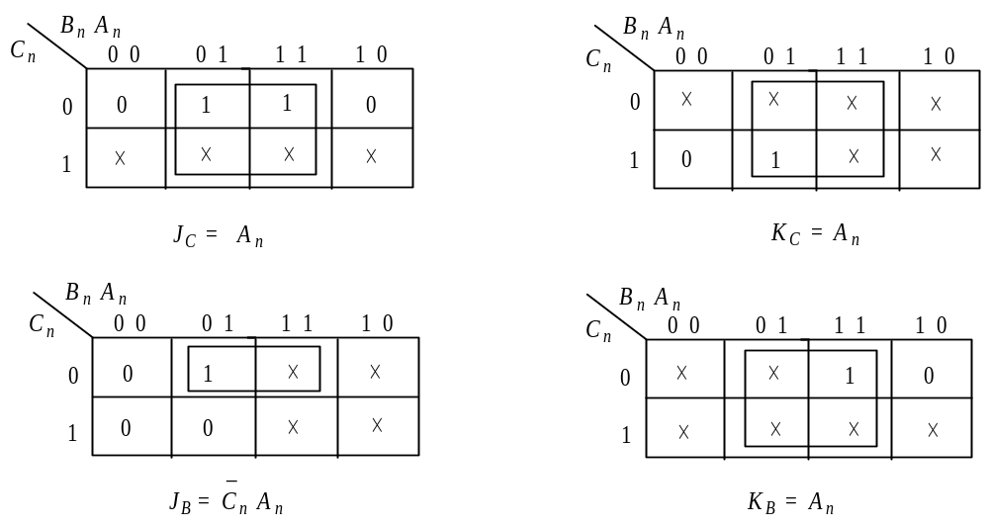
Counter design as a synthesis problem
Our next objective is to get logic equation for each flip-flop input as a function of present state of the counter.

Slide 13
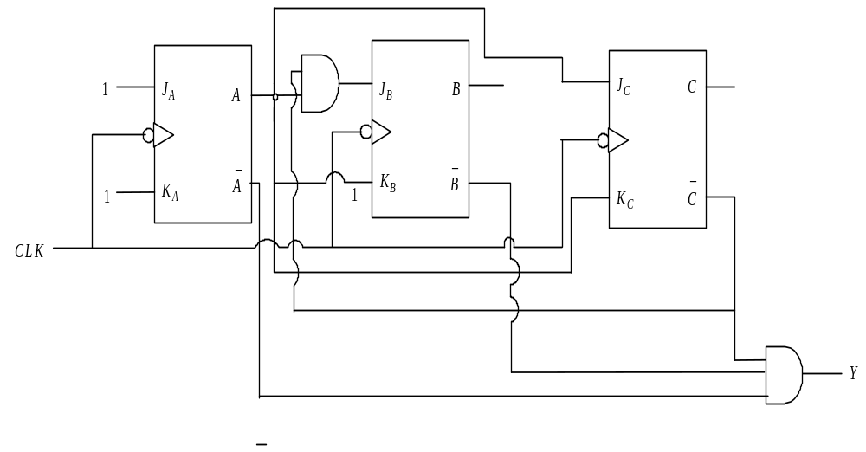
Counter design as a synthesis problem
The final step is to draw the circuit diagram from the design equations, which is shown in previous slide.
Circuit diagram of modulo-6 synchronous counter

Slide 14
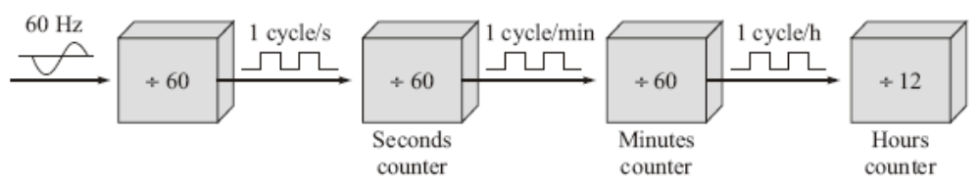
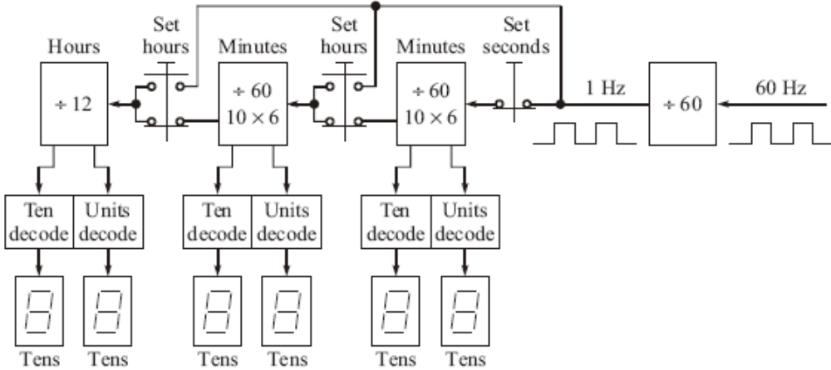
A Digital Clock
Digital Clock block diagram.
Digital Clock

Slide 15
COUNTER DESIGN USING HDL
Counter design in HDL is straight forward if one uses arithmetic operator + and – that corresponds to binary addition and subtraction respectively.
module UC(Clock, RESET,Q); input Clock, RESET; output [2:0] Q; //modulo 8 requires 3 flip flop reg [2:0] Q; always @ (negedge Clock) if (~RESET) Q=3’b0; else Q = Q+1; endmodule | module UCJK(Clock, A,B); input Clock; output A,B; //modulo-3 requires 2 flip flop wire JA,JB,KA,KB; assign JA=~B; assign KA=1’b0; assign JB=A; assign KB=1’b0; JKFF JK1(JA,KA,Clock,A); //instantiates JKFF JKFF JK2(JB,KB,Clock,B); //instantiates JKFF endmodule module JKFF(J,K,Clock,Q); input J,K,Clock; output Q; reg Q; always @ (negedge Clock) Q = (~J&Q) | (~K&Q); Endmodule

